Slide 1
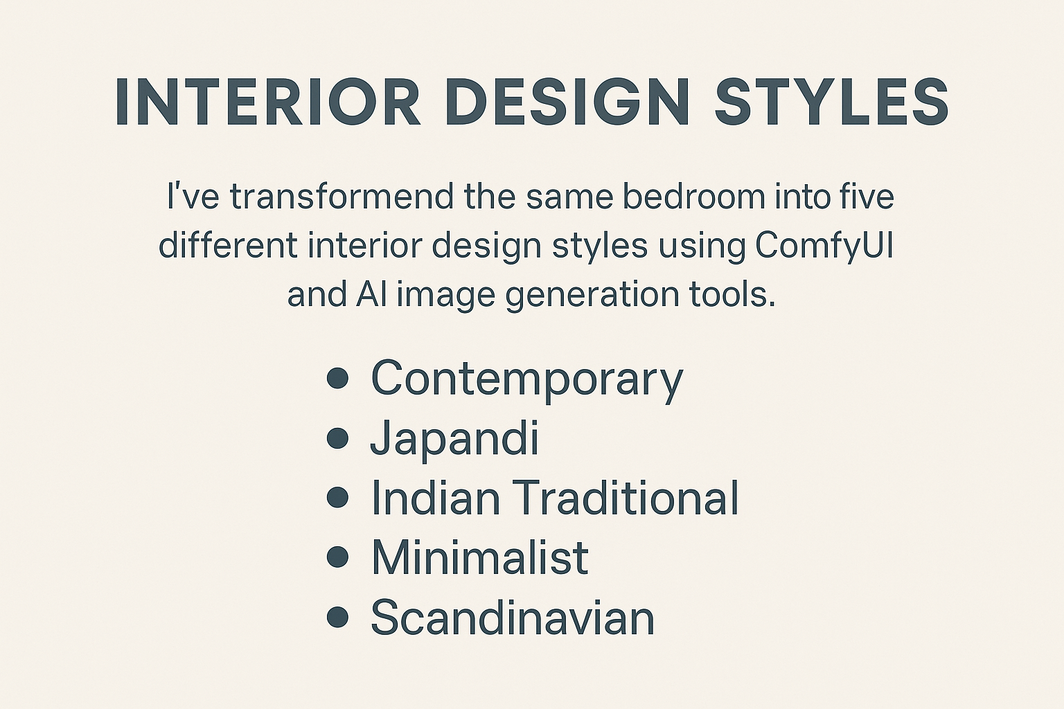

Slide 2
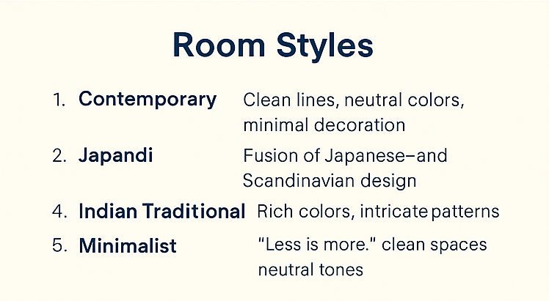
Notes:
3. Scandinavian: Similar to minimalist, bit warmer, pale wood and soft cushions

Slide 3
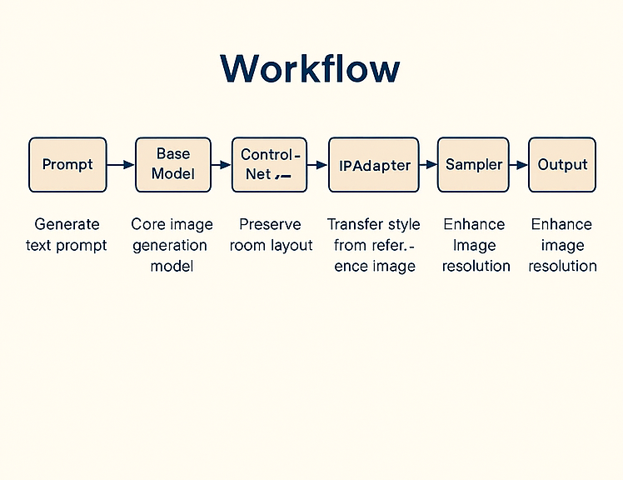

Slide 4


